Slide 1
IPOVITAMINOSI E DEFICIT DI MICRONUTRIENTI DOPO CHIRURGIA BARIATRICA
Prof. LUIGI SCHIAVO
PROFESSORE Associato di nutrizione umana e dietetica applicata
Dipartimento di medicina, chirurgia e odontoiatria
università degli studi di Salerno
RESPONSABILE AMBULATORIO dietetica E NUTRIZIONE
UOC CLINICA MEDICA ed epatologica, AOU san Giovanni di dio e ruggi D'Aragona, SALERNO
Delegato Campano Soci Affini SICOB

Slide 2
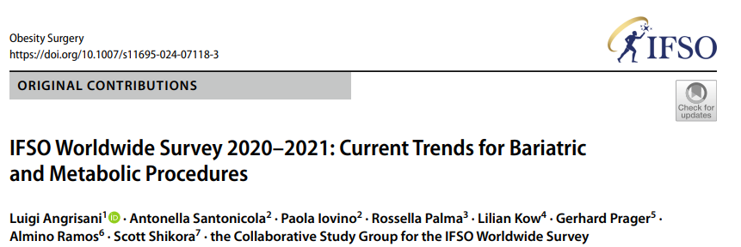
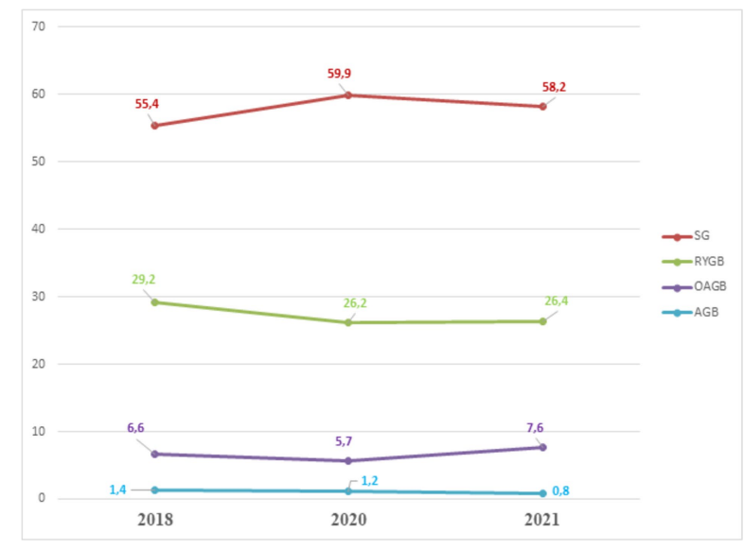
2024
2021: SG and Roux-en-Y gastric bypass (RYGB) constitutes 95% of the total MBS performed in the World
%
Worldwide trend in the percentage of the main surgical metabolic and bariatric (MBS) from 2018 to 2021 confirmed that the sleeve gastrectomy (SG) was the most performed MBS in the world

Slide 3
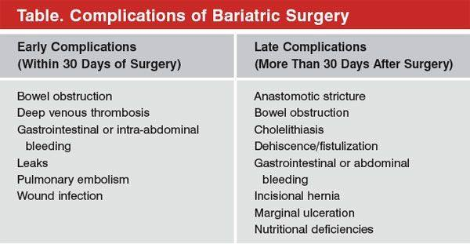
Micronutrient Deficiencies (MD) after MBS
MD, is an important complication associated with MBS with 50% of cases of vitamin deficiency (VD) being observed at the end of the first postoperative year

Slide 4
Micronutrient Absorption in the Gastro Intestinal Tract (GIT): Physiology
MD secondary to RESTRICTIVE or MALABSORPTIVE bariatric procedures are explained by different factors.

Slide 5
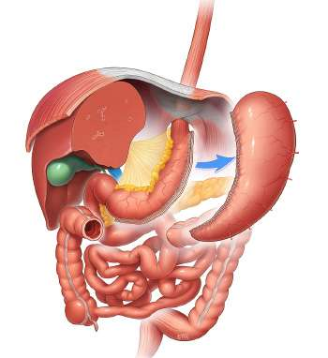
Sleeve Gastrectomy
SG affects the MICRONUTRIENTS status by changing:
Gastrointestinal motility
Gastric emptying
Gastro-duodenal transit time
HCL secretion
IF secretion
a type of weight-loss surgery that involves removing part of the stomach to make it smaller

Slide 6
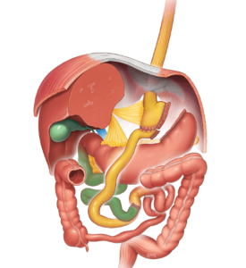
Roux-en-Y gastric bypass
(RYGB)
Roux-en-Y gastric bypass (RYGB) affects the MICRONUTRIENT status by:
Changing the size of the stomach
Changing the gastrointestinal transit time
Bypassing the duodenum
The main cause of MD after RYGB is bypassing the main sites
where the absorption of micronutrient occurs

Slide 7
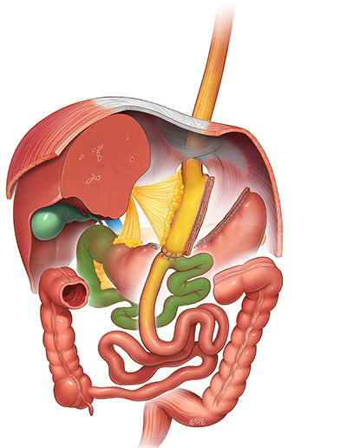
One Anastomosis gastric bypass
(OAGB)
One-Anastomosis Gastric Bypass (OAGB) affects the MICRONUTRIENT status by:
Changing the size of the stomach
Bypassing part of the small bowel (duodenum and part of the jejunum).
The main cause of MD after OAGB is bypassing the main sites where the absorption of micronutrients occurs

Slide 8
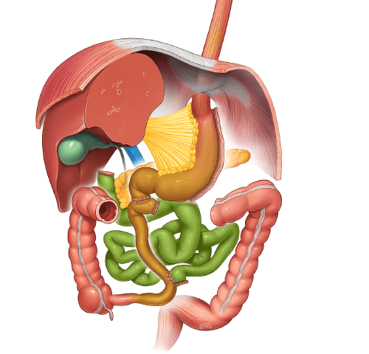
Biliopancreatic diversion
with duodenal switch (BPD-DS)
Biliopancreatic diversion with duodenal switch (BPD-DS) affects the MICRONUTRIENT status by:
Exclusion of the jejunum from the alimentary tract
The short common channel of the BPD-DS deteriorates the absorption of fat-soluble vitamin (A, D, E, and K).
The main mechanism contributing to fat-soluble vitamin deficiencies is delayed mixing of dietary fat with pancreatic enzymes and bile salts, creating fat malabsorption.

Slide 9
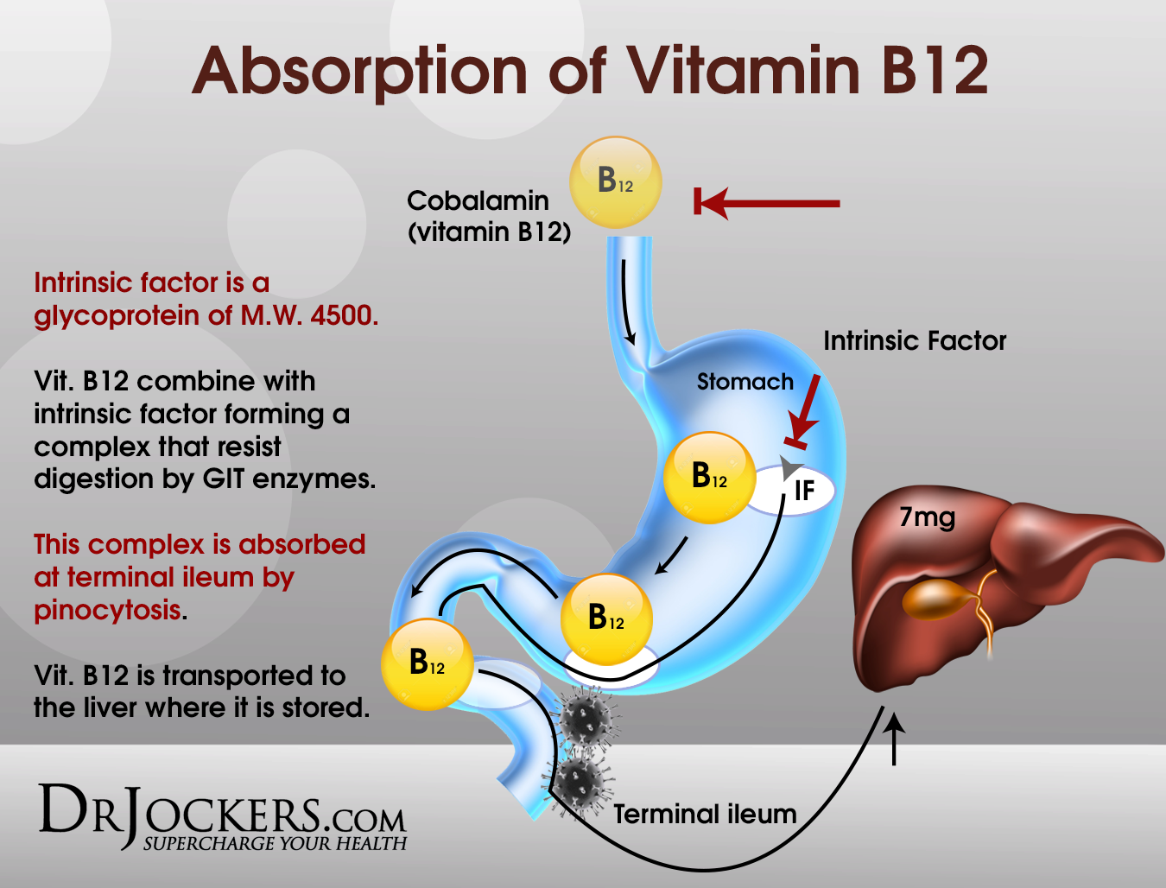
Vitamin B₁₂ (Cobalamin)
deficiency is reported in 10–20% of SG patients
Intrinsic factor (IF), synthesized by the parietal cells of the stomach, plays a major role in cobalamin absorption
Sleeve Gastrectomy (SG)
After SG, gastric fundus resection result in decreased secretion of IF
Decreased IF secretion is currently considered the main driver of the post-surgical B₁₂ deficiency
Administration of high doses of B12 is recommended to be initiated right after BMS
350–500 mcg daily (sublingual/liquid) or 1000 mcg monthly (parenteral)
Obeid, R et al. Vitamin B12 Intake From Animal Foods, Biomarkers, and Health Aspects. Front Nutr. 2019, 6, 93.
Parrott, J et al. ASMBS Integrated Health Nutritional Guidelines for the Surgical Weight Loss Patient 2016 Update: Micronutrients. Surg. Obes. Relat. Dis. 2017, 13, 727–741.

Slide 10
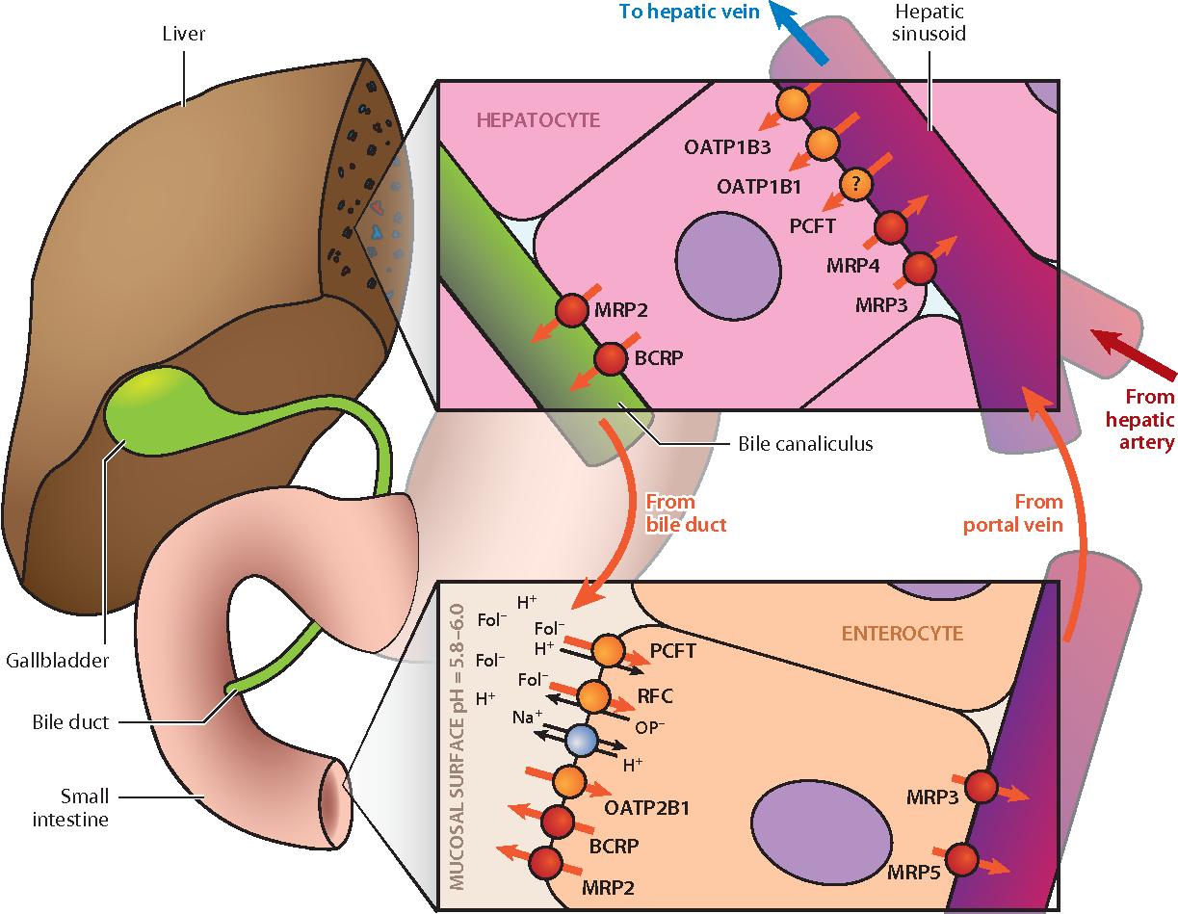
Folate
Folate deficiency ranges between 9% and 39% following both malabsorptive and restrictive procedures and is mostly due to:
the depletion of tissue stores as a result of inadequate dietary intake
an impaired absorption due to the decrease of HCl secretion
an altered intestinal pH
Folate absorption occurs primarily in the upper small intestine (proximal jejunum)
Postoperative supplementation following RYGB with physiologic doses (400 mcg) is generally sufficient to prevent or correct the folate deficiency
Parrott, J et al. ASMBS Integrated Health Nutritional Guidelines for the Surgical Weight Loss Patient 2016 Update: Micronutrients. Surg. Obes. Relat. Dis. 2017, 13, 727–741.

Slide 11
Vitamin B₁ (Thiamine)
27% of patients who underwent BS eperience vitamin B1 deficiency within 6 months following surgery, mostly due to hyperemesis.
Thiamine absorption occurs primarily in the jejunum.
Intractable vomiting impairs absorption of thiamine and so deficiency can occur despite oral supplementation.
Therefore, early diagnosis of thiamine deficiency is crucial to prevent permanent sequelae, such as Wernicke Encephalopathy (WE)
12 mg daily/50 mg dose from B-complex supplement/multivitamin twice daily
Parrott, J et al. ASMBS Integrated Health Nutritional Guidelines for the Surgical Weight Loss Patient 2016 Update: Micronutrients.
Surg. Obes. Relat. Dis. 2017, 13, 727–741

Slide 12
Vitamin D
Absorption of vitamin D occurs mostly in the jejunum and ileum through passive diffusion, a mechanism which rather requires the presence of bile salts
Vitamin D deficiency is common following bariatric surgery
and has been reported to occur in 50-80% of patients
3000 IU daily until plasma concentration
exceeds 30 ng/mol
Parrott, J et al. ASMBS Integrated Health Nutritional Guidelines for the Surgical Weight Loss Patient 2016 Update: Micronutrients. Surg. Obes. Relat. Dis. 2017, 13, 727–741.

Slide 13
Vitamin A, E, and K
The frequency of these nutritional deficiencies following BS is generally low.
Vitamin A deficiency following RYGB ranges between 8% and 11%
Vitamin E deficiency is present in 8.7% of patients 1 year following RYGB
Vitamin K deficiency is rare
Vitamin A, 5000–10,000 IU/day
Vitamin E, 15 mg/day
Vitamin K, 90–120 ug/day
Parrott, J et al. ASMBS Integrated Health Nutritional Guidelines for the Surgical Weight Loss Patient 2016 Update: Micronutrients. Surg. Obes. Relat. Dis. 2017, 13, 727–741.

Slide 14
Post-MBS Anemia
American Society of Hematology: 33%-49% of operated patients presenting anemia within 2 years after surgery.
As expected, the average prevalence of anemia is lower following LSG (17%) and reaches 45%-50% after RYGB and BPD
Post-bariatric anemia is in most cases due to:
the bypassing of the duodenum and proximal jejunum (which are the main sites of iron absorption) are the primary mechanisms that lead to iron deficiency.
Reduced iron absorption due to hypochloridria
Post-operative reduction in food intake
Changes in food preferences such as intolerance for meat and dairy products, are important contributory factors.
However, for the correction of iron deficiency (when iron deficiency sets in), oral supplementation is not sufficient, and intravenous iron administration is required.
Parrott, J et al. ASMBS Integrated Health Nutritional Guidelines for the Surgical Weight Loss Patient 2016 Update: Micronutrients. Surg. Obes. Relat. Dis. 2017, 13, 727–741.

Slide 15
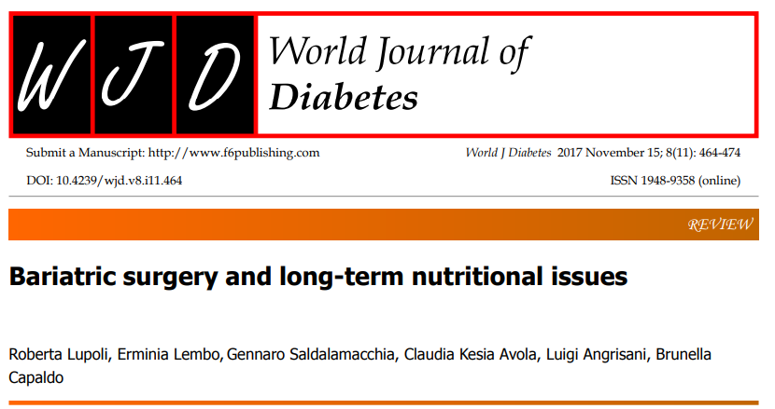
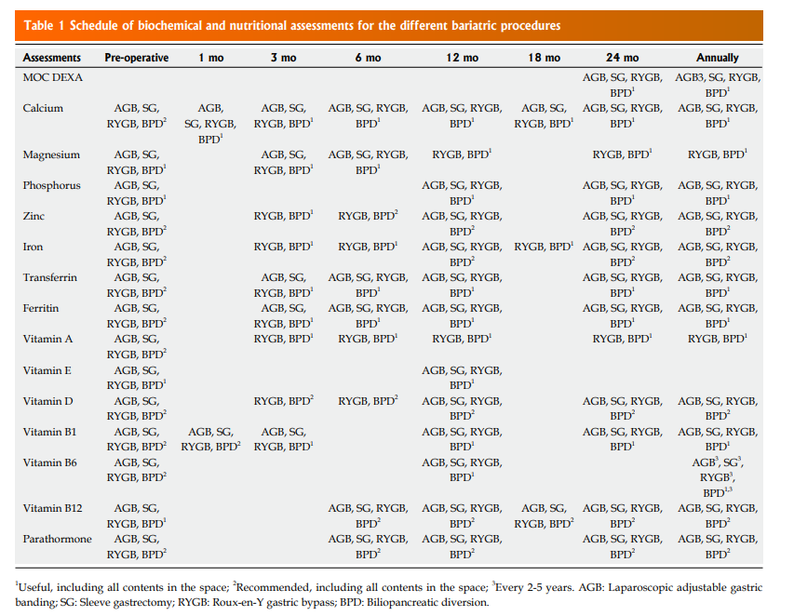
The best practices guidelines highly recommend regular metabolic and nutritional monitoring after MBS, which frequency varies according to the type of procedure.
Considering the high prevalence of nutrient deficiencies even prior to surgery, the current Guidelines also underscore the need for a complete pre-surgery nutritional assessment in all candidates for bariatric surgery.

Slide 16
CONCLUSIONS AND TAKE HOME MESSAGE
BS may increase the risk of MD as a result of modifications to the gastrointestinal anatomy and physiology; however, confounders including preoperative deficiency, eating behavior, supplementation and inflammation are also to be considered
The best practices guidelines highly recommend regular metabolic and nutritional monitoring after BS, which frequency varies according to the type of procedure to identify MD earlier and allows for intervention before development of clinical symptoms.
A more individualized, person-centred approach may be safe and efficacious, within a supportive nutritionist with expertise in BS and the administration of multivitamins especially formulated for BS patients
Grazie lschiavo@unisa.it

